Slide 1


2022 Caucus Tech
Volunteer Training
Welcome! Introduce yourself with your name and town or city and ward in the chat.
Notes:
We’re going to be sharing this slide deck after the training
We’re going to have teller trainings, AND a separate video about breakout rooms
We have a slide deck about setting up each Zoom setting that we can share as well

Slide 2

What will we cover?
What caucuses look like this year
Being a tech volunteer
Pre-Caucus Meetings
Tech Volunteer Checklist
  Pre-Caucus (ASAP)
  24-Hours Pre-Caucus
  Caucus Day
Nominations and Voting
After the Caucus
Notes:
In order to comply with public health guidelines and ensure all Democrats have the opportunity to participate, caucuses must be EITHER entirely virtual OR outdoor and socially distanced with an option to participate virtually.

Slide 3
What does caucusing look like this year?
VIRTUAL CAUCUS: An entirely virtual caucus hosted over Zoom or another conferencing tool
HYBRID CAUCUS: Some people will meet physically, but others will participate virtually
Caucuses generally take an ~90 minutes, but ask your chair what past precedence is
Notes:
In order to comply with public health guidelines and ensure all Democrats have the opportunity to participate, caucuses must be EITHER entirely virtual OR outdoor and socially distanced with an option to participate virtually.

Slide 4
Being a tech volunteer
Have a Pre-Caucus Meeting with your Chair and other Volunteers
Work with the chair to prepare Zoom settings in advance of meeting
Use sheets and forms for sign in and voting during caucus
Ascertaining party registration of attendees
  List of Registered Voters from the Local Election Official or Votebuilder
    Register to vote here
Provide the election results to the Chair so they can announce results.
Provide delegate questionnaire, payment, and fee waiver links to the elected delegates and alternates using the zoom chat.
Notes:
You don’t need to know Robert’s Rules; you will NOT be running the caucus! Your role is designed to be behind the scenes, helping the chair, dropping links in the chat, making sure Zoom settings are correct.

Slide 5

Pre-Caucus Meeting
The chair and volunteers will meet prior to the caucus– ask your chair when you will meet.
Sample Agenda:
Who owns the Zoom link? (Should not be a free Zoom Account)
Who will need to be “co-hosts”?
Zoom settings (enabled before caucus)
Renaming participants
Are we using breakout rooms?
How are we confirming voter registration?
Are there other volunteers? What are their roles?
  Registration, Tellers, and Timekeeper
Voting procedure
  Voice Vote, Zoom Chat, or Google Form
Zoom Chat Post Caucus Forms

Slide 6
Checklist: Pre-Caucus (ASAP)
Work with your Chair to ensure proper zoom settings. The Chair will need a Zoom Pro Account for the caucus and to utilize the following capabilities:
Zoom Registration Required
Zoom Registration Questions:
  Last Name
  Address
  Phone
  Gender/Nonbinary
  Ward (Cities Only)
Closed Captioning Enabled
Breakout Rooms (for Cities with Wards)
To learn more about these Zoom settings, click here to view our instructions or use the ones provided by zoom here.
The Chair will need to obtain the list of registered voters from the Local Election Office. This should be done seven days prior to caucus.

Slide 7
Checklist: 24-Hours Pre-Caucus
You can start getting ready for your caucus by preparing the sign in sheet. You should begin by:
Downloading the Zoom Registration. The individual who created the meeting will have access to this information.
  From the CSV, copy and paste the Zoom registration info into your Sign In Sheet.
Check Voter Registration of Attendees who pre-registered for Zoom. Indicate that the individual is a registered Democrat in Column “I” by marking them off as Attending.
Notes:
VoteBuilder will be up-to-date through Jan 1 2022
In order to comply with public health guidelines and ensure all Democrats have the opportunity to participate, caucuses must be EITHER entirely virtual OR outdoor and socially distanced with an option to participate virtually.

Slide 8
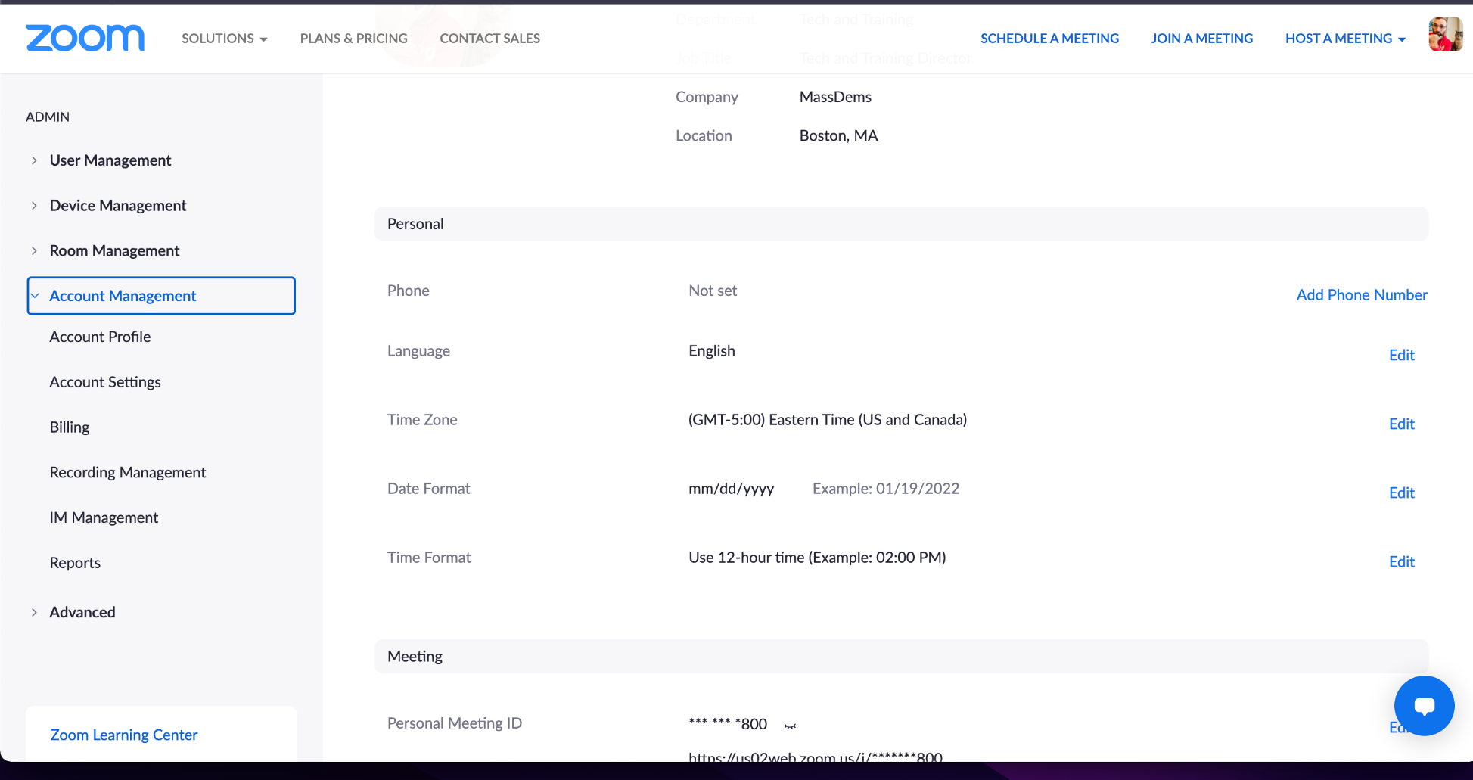
Download your Zoom Registration Info
From the Zoom account that created the meeting, navigate to Account “Management” and “Reports.”
Notes:
Go to Zoom.us and login
Click on 'reports' on the left
Click on usage reports --> meetings
Make sure you have 'registration report' checked off, and the caucus is in between the dates it is searching for
Click 'generate --> all registrants' on the right hand side
Click 'download' on the one you're looking for and that downloads the CSV

Slide 9
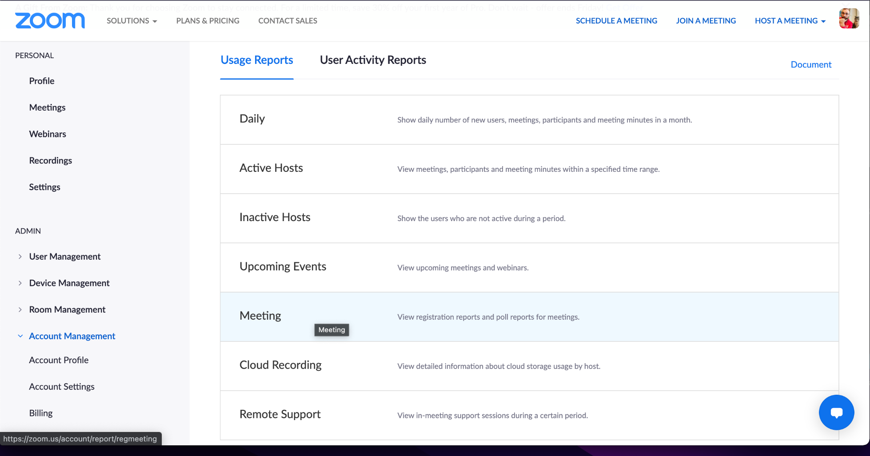
Download your Zoom Registration Info
Then select Meeting.
Notes:
Go to Zoom.us and login
Click on 'reports' on the left
Click on usage reports --> meetings
Make sure you have 'registration report' checked off, and the caucus is in between the dates it is searching for
Click 'generate --> all registrants' on the right hand side
Click 'download' on the one you're looking for and that downloads the CSV

Slide 10
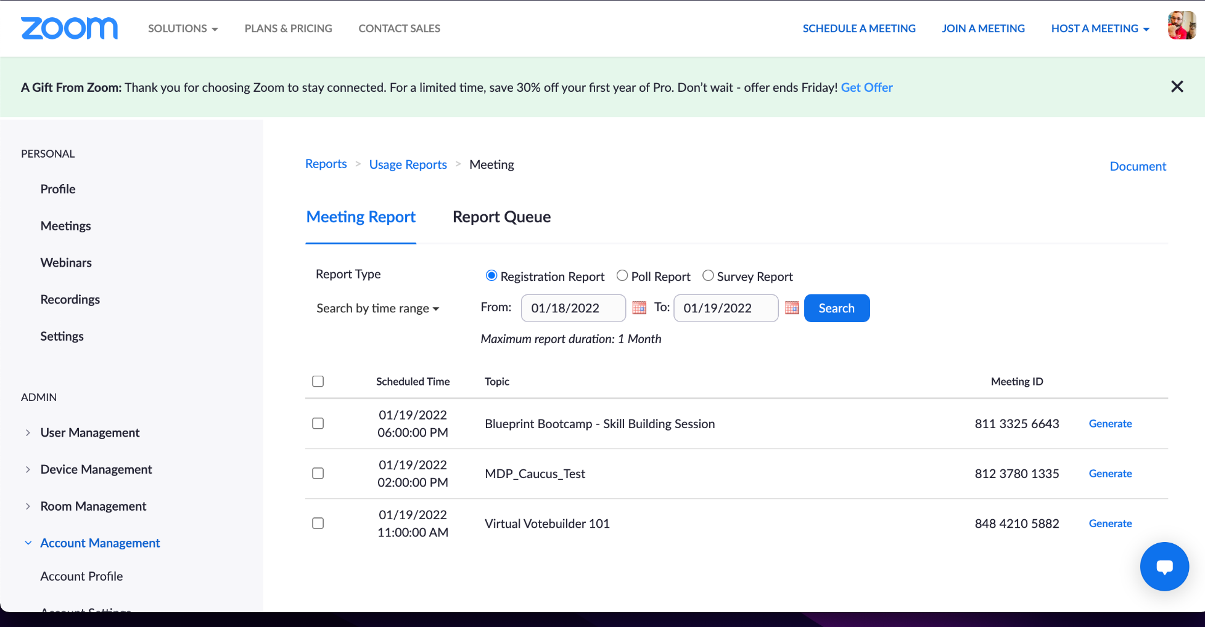
Download your Zoom Registration Info
Select “Generate” next to the Zoom meeting of the scheduled caucus.
Notes:
Go to Zoom.us and login
Click on 'reports' on the left
Click on usage reports --> meetings
Make sure you have 'registration report' checked off, and the caucus is in between the dates it is searching for
Click 'generate --> all registrants' on the right hand side
Click 'download' on the one you're looking for and that downloads the CSV

Slide 11
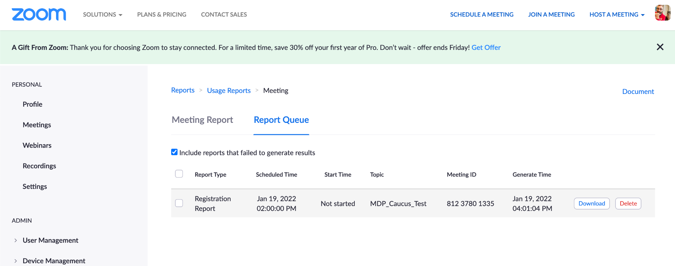
Download your Zoom Registration Info
Select “Download” of your recently generated report.
Step by step instructions are on the next slide. You can also click this link to see more from Zoom.
Notes:
Go to Zoom.us and login
Click on 'reports' on the left
Click on usage reports --> meetings
Make sure you have 'registration report' checked off, and the caucus is in between the dates it is searching for
Click 'generate --> all registrants' on the right hand side
Click 'download' on the one you're looking for and that downloads the CSV

Slide 12
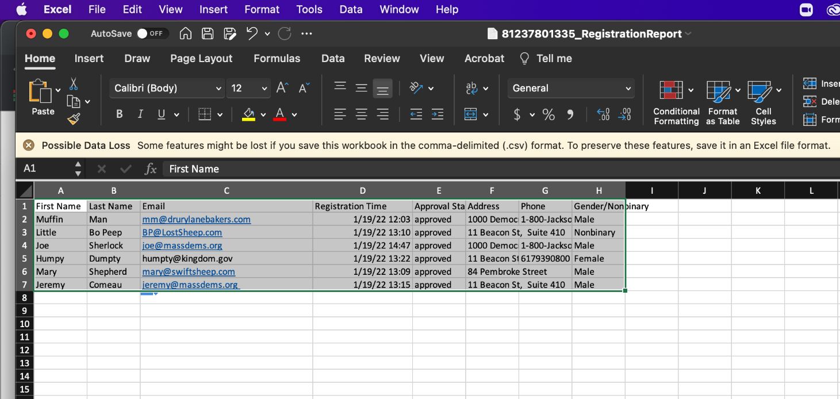
Copy info from Zoom Registration to Sign In Sheet
Open the new file in excel and highlight the rows starting with the second row and copy the information.
PC: Ctrl-C Mac: Command-C.

Slide 13
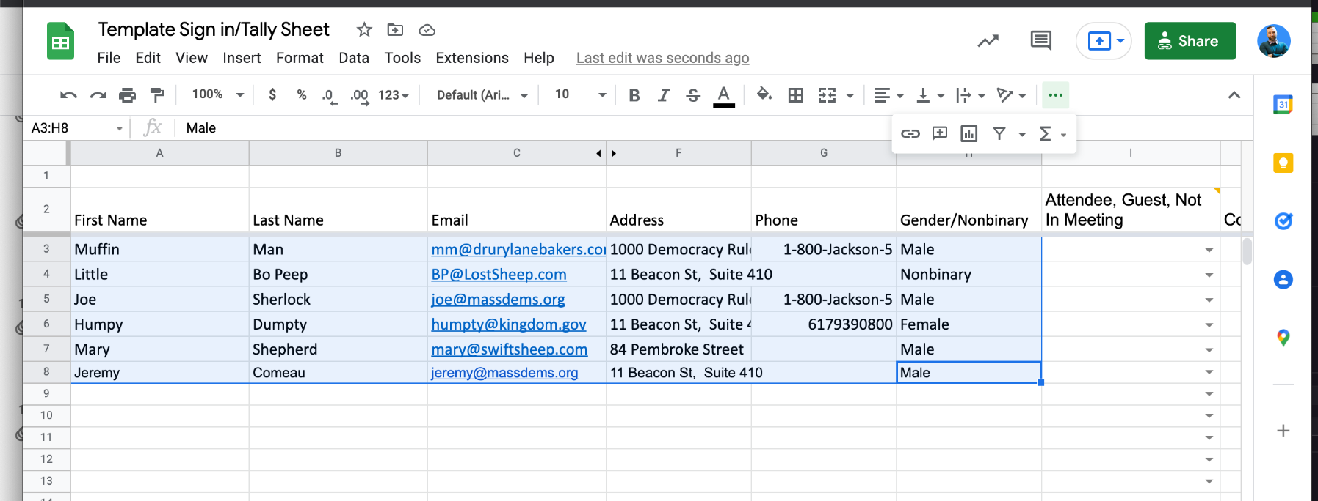
Copy info from Zoom Registration to Sign In Sheet
Then open your sign in sheet and paste the information.
PC: Ctrl-V Mac: Command-V.

Slide 14
Step by Step: Downloading your Zoom pre-registration list
Go to Zoom.us and login
Click on 'reports' on the left
Click on usage reports --> meetings
Make sure you have 'registration report' checked off, and the caucus is in between the dates it is searching for
Click 'generate --> all registrants' on the right hand side
Click 'download' on the one you're looking for and that downloads the CSV

Slide 15
Check Voter Registration
You or another volunteer should check the voter registration of everyone who registered for the Zoom meeting. Verify Democratic registration or pre-registration:
List of registered voters from Local Election Official
Votebuilder
REMIND potential caucus goers to REGISTER for the Zoom meeting well in advance so you can look up their registration status before the caucus begins.
Notes:
Will be up to Jan 1, 2022 date

Slide 16
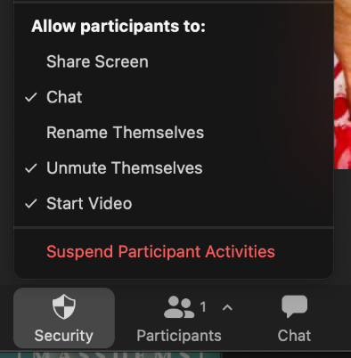
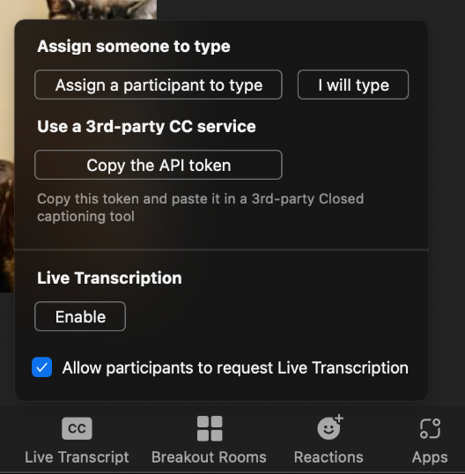
Checklist: Caucus Day
Co-Host/Hosting for Tech Volunteer and other Vols
Zoom Settings:
  “Chat”, “Unmute Themselves”, and “Start Video” functions are CHECKED,
  “Rename Themselves” and “Share Screen” functions are UNCHECKED.
            Closed Captions: Enable Live Transcript
Notes:
Once the Zoom host has clicked on security, they can make sure that Unmute Themselves, and Start Video functions are checked on, but “Rename Themselves” and “Share Screen” functions are checked off. After the 15 minutes have elapsed at the start of the caucus, only members must have signed in during the 15 minute window will be eligible to vote. Also, change column “I” to “Not in Meeting” if they registered for the zoom but didn’t show up for caucus

Slide 17
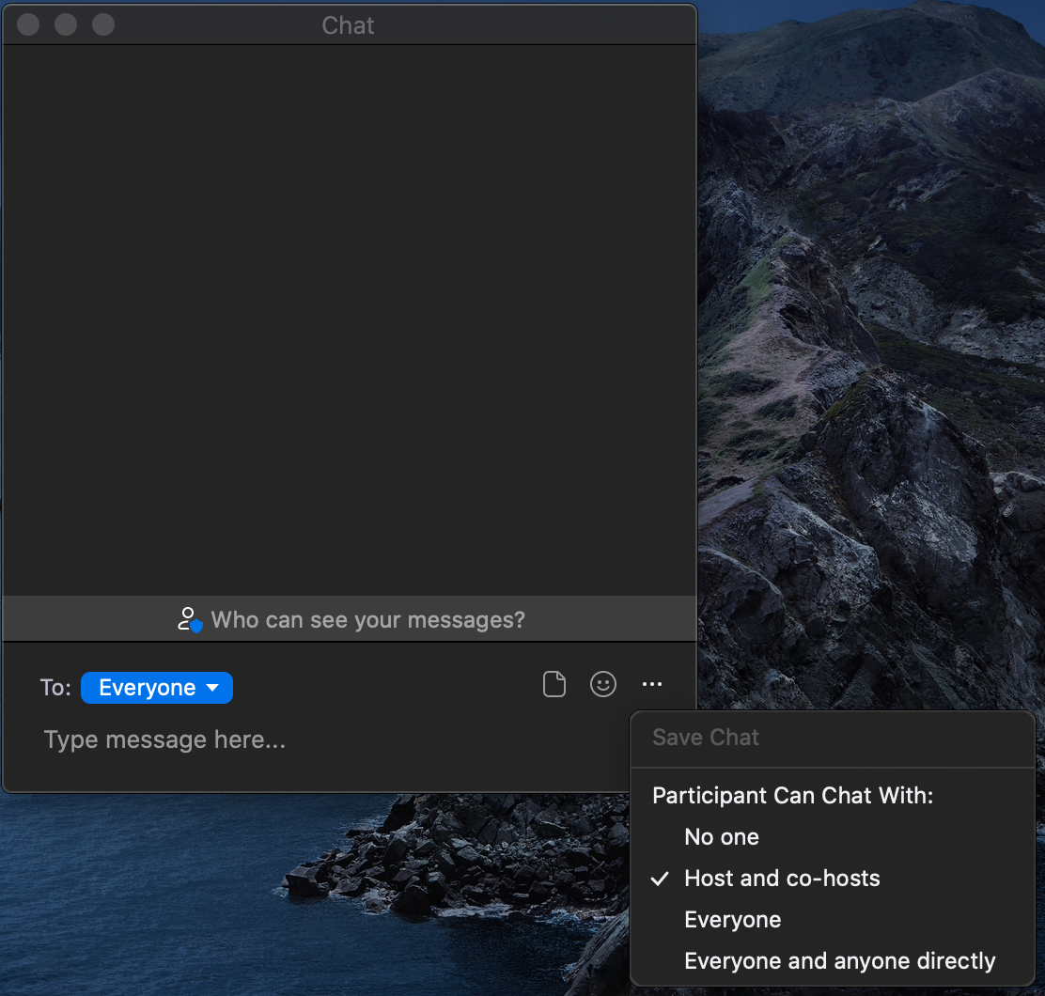
Checklist: Caucus Day
So participants only chat their votes to the teller, set chat to “hosts and co-hosts”
You’ll open the chat, click on the 3 little dots on the right, and select “Hosts and co-hosts”
Notes:
Once the Zoom host has clicked on security, they can make sure that Unmute Themselves, and Start Video functions are checked on, but “Rename Themselves” and “Share Screen” functions are checked off. After the 15 minutes have elapsed at the start of the caucus, only members must have signed in during the 15 minute window will be eligible to vote. Also, change column “I” to “Not in Meeting” if they registered for the zoom but didn’t show up for caucus

Slide 18
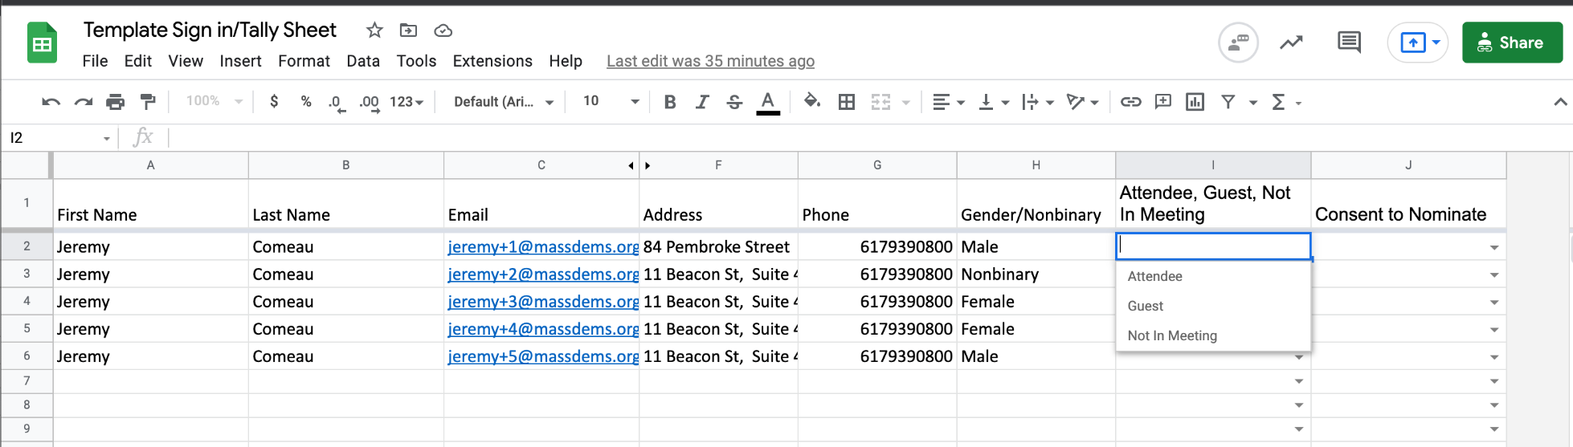
Checklist: Caucus Day
Co-Host status for Tech Volunteer and other Vols
Zoom Settings:
  Unmute Themselves, and Start Video functions are CHECKED
  "Chat" “Rename Themselves” and “Share Screen” functions UNCHECKED
Closed Captions: Enable Live Transcript
When Chair and other volunteers are ready, admit participants individually in order to mark the individual as attending and to check voter registration for participants who didn't register in advance of the meeting.
Notes:
Once the Zoom host has clicked on security, they can make sure that Unmute Themselves, and Start Video functions are checked on, but “Rename Themselves” and “Share Screen” functions are checked off. After the 15 minutes have elapsed at the start of the caucus, only members must have signed in during the 15 minute window will be eligible to vote. Also, change column “I” to “Not in Meeting” if they registered for the zoom but didn’t show up for caucus

Slide 19
Checklist: Caucus Day
Co-Host status for Tech Volunteer and other Vols
Zoom Settings:
  Unmute Themselves, and Start Video functions are CHECKED
  "Chat" “Rename Themselves” and “Share Screen” functions UNCHECKED
Closed Captions: Enable Live Transcript
When Chair and other volunteers are ready, admit participants!
Smaller caucuses can individually in order to mark the individual as attending and to check voter registration for participants who didn't register in advance of the meeting.
Notes:
Once the Zoom host has clicked on security, they can make sure that Unmute Themselves, and Start Video functions are checked on, but “Rename Themselves” and “Share Screen” functions are checked off. After the 15 minutes have elapsed at the start of the caucus, only members must have signed in during the 15 minute window will be eligible to vote. Also, change column “I” to “Not in Meeting” if they registered for the zoom but didn’t show up for caucus

Slide 20
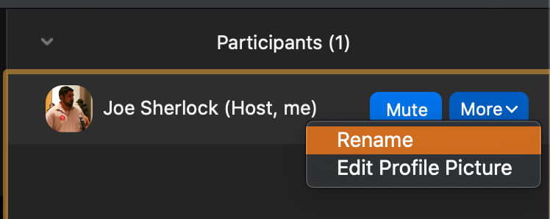
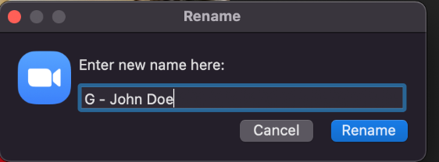
Checklist: Caucus Day
Rename any non-voters with a “G” for Guest
15-minute window: attendees who join meeting 15 minutes after scheduled caucus can participate as guest but not voters or candidates.
Notes:
The reasons you do this–
Keeps you organized
Let’s them know if they’re signed in

Slide 21
Nominations and Voting
Chairs have discretion on which voting process to use:
Smaller caucuses may want to use a voice vote.
Ask participants to vote in the Zoom chat and count them
  Have a ‘Teller’ who counts the votes using a printed tally sheet or the templated tally spreadsheet.
Use Google Forms for larger caucuses.

Slide 22
Nominations and Voting
Determine who will provide attendees with a list of candidates (after nominations, chair, tech volunteer, or other officer?) Consider using a word document and the screen share option.
Have volunteers as tellers. The teller will count the votes.
Rename the teller’s zoom name to “Teller A, John Doe” to help caucus attendees

Slide 23

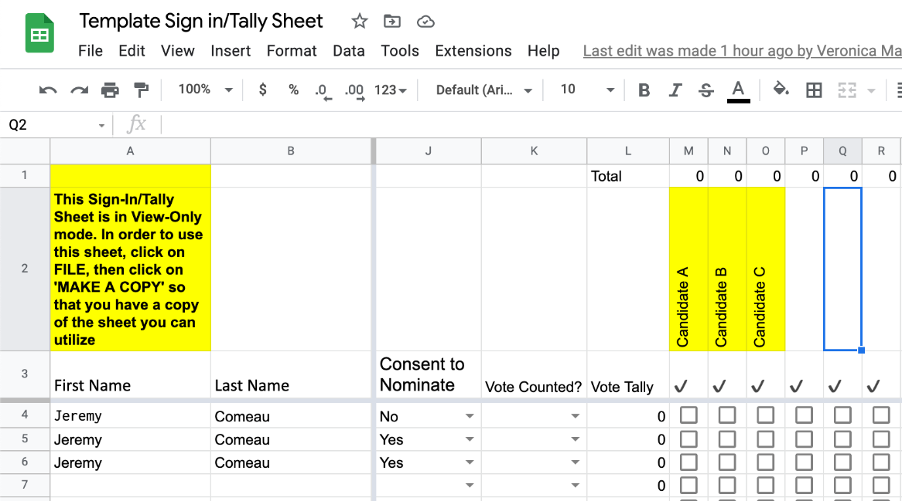
Nominations and Voting
Tellers may use either a printed tally sheet provided in the Preliminary Call to Convention or the virtual template. The printed sheet will only work if there is one teller for the caucus. If there are multiple tellers, please use the the template tally sheet.
Tellers list all nominated candidates on the tally sheet in row 2.
Notes:
Once the Zoom host has clicked on security, they can make sure that Unmute Themselves, and Start Video functions are checked on, but “Rename Themselves” and “Share Screen” functions are checked off. After the 15 minutes have elapsed at the start of the caucus, only members must have signed in during the 15 minute window will be eligible to vote. Also, change column “I” to “Not in Meeting” if they registered for the zoom but didn’t show up for caucus

Slide 24
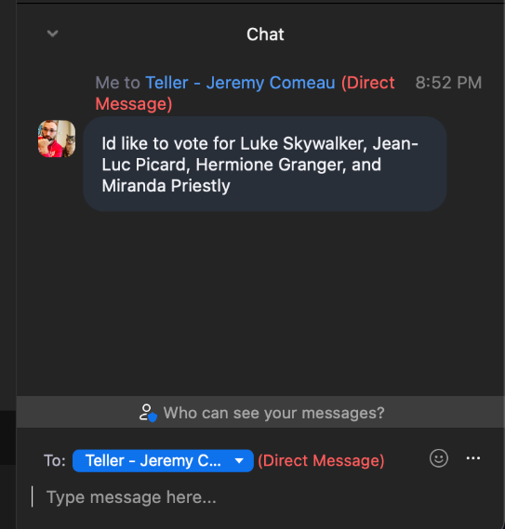
Nominations and Voting
When voting begins, the chair will instruct attendees to privately chat the teller the first and last names of all candidates they’re voting for in one message.
Starting in chronological order, the teller will count each attendee’s votes fully before moving on to the next attendee. If using the google spreadsheet, the teller will mark who has voted in the sign in/tally sheet after recording.
If there are attendees calling in to participate, consider calling those individuals to take their vote or ask them to text you if they are comfortable doing so.
Notes:
Once the Zoom host has clicked on security, they can make sure that Unmute Themselves, and Start Video functions are checked on, but “Rename Themselves” and “Share Screen” functions are checked off. After the 15 minutes have elapsed at the start of the caucus, only members must have signed in during the 15 minute window will be eligible to vote. Also, change column “I” to “Not in Meeting” if they registered for the zoom but didn’t show up for caucus

Slide 25
Nominations and Voting
The teller needs to check a few things before finalizing results for the chair:
That they received all the votes! Remember, participants may still have sent their votes to the chair or the tech volunteer by accident.
That folks only voted for the number of delegates they’re allowed to vote for.
  I.e. if your town is allocated 3 delegates, folks can only vote for up to 3 delegates (not more).
That everyone had a chance to vote. Check on your folks who have dialed in on the telephone and folks who are working hard to navigate Zoom. Again, Tellers will need to call or text folks who have dialed in to the meeting. The teller should scroll through the chat a second time to ensure all attendees have been marked as voting on the tally sheet.
Finally, the teller should send the chair the results who should be responsible for announcing the results.

Slide 26
Nominations and Voting
After the caucus, KEEP PEOPLE ON THE CALL!
The Chair or someone from the DTC leadership can also email all required digital forms to the newly elected delegates and alternates which includes:
Delegate/alternate/ex-officio certification forms
Delegate Fee via ActBlue
Fee waiver forms (if applicable)
The Chair is required to return the following forms by mail:
Chair Certification Form
Sign in sheet--digital or paper
For attendees who were not elected as a delegate but would like to attend the convention as an Add-On Delegate, they must fill out the Add-on delegate form online.

Slide 27
Questions?
Get in touch at convention@massdems.org

